Slide 1
Sharks

Slide 2
Sharks are a group of elasmobranch fish characterized by a cartilaginous skeleton, five to seven gill slits on the sides of the head, and pectoral fins, that are not fused to the head.
Sharks range in size from the small dwarf lanternshark(17 cm) to bigger ones like whale shark (more than 12 m, that makes it the biggest shark in the world)
They generally do not live in freshwater, although there are a few known exceptions, such as the bull shark and the river shark, which can be found in both seawater and freshwater.
Basic Information

Slide 3
Shark Attacks
Shark attacks are most typical for Australia, America and sometimes even in Mediterranean sea.
From all 470 shark species are only known around 4 to be dangerous to humans.
Sharks attack only because of stress, hunger or curiousity so we dont have to worry about being attacked anytime we are in the water.

Slide 4
Shark fishery
Sharks are being hunted because of their fins to be produced into some kind of Asian medicine, shark fin soup, shark meat and as a trophies and their teeth and jaws.
Shark fishery is making some of shark species dissaper faster than others, specially mako shark, also catshark species and greenland sharks.

Slide 5
Video of shark hunting
https://www.youtube.com/watch?v=XtSAnt2HnhU

Slide 6
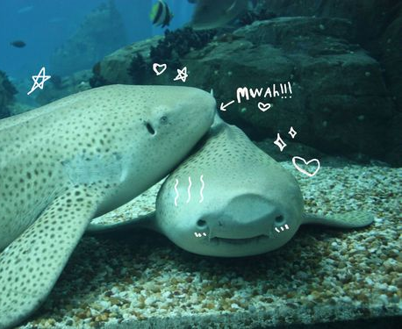
The end!

