Slide 1
Michal Šindýlek
Chess

Slide 2
Chess rules:
Rook: the rook moves in straight lines in all directions
Worth 5 points

Slide 3
Bishop:
The bishop moves in any direction diagonally
Worth 3 points

Slide 4
Knight
The knight by far has the weirdest movement as it moves in an L and can jump over pieces
Worth 3 points

Slide 5
queen
The queen moves like both the bishop and the rook combined
Worth 9 points

Slide 6
pawn
The pawn on its starting square can move 1 or 2 squares forward and for the rest of the game it can only move 1 square. And it also captures pieces diagonally

Slide 7
pawn
When the pawn reaches the end of the board it can turn into a queen, rook, bishop or a knight
Worth 1 point

Slide 8
king
The king is worth everything and if it is captured the game ends it moves one space in any direction

Slide 9
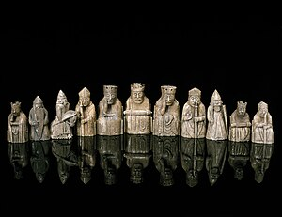
History
Chess was invented 1500 years ago
And at first it was called chaturanga
And it was invented in india

Slide 10
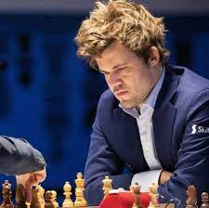
Chess players
Magnus carlsen 2830
Fabiano caruana2804
Hikaru nakamura2788
Ding liren 2782
Wesley so 2757

Slide 11
Chess puzzles
https://www.chess.com/blog/Win_Like_McEntee/1-move-checkmate-puzzles

