Slide 1
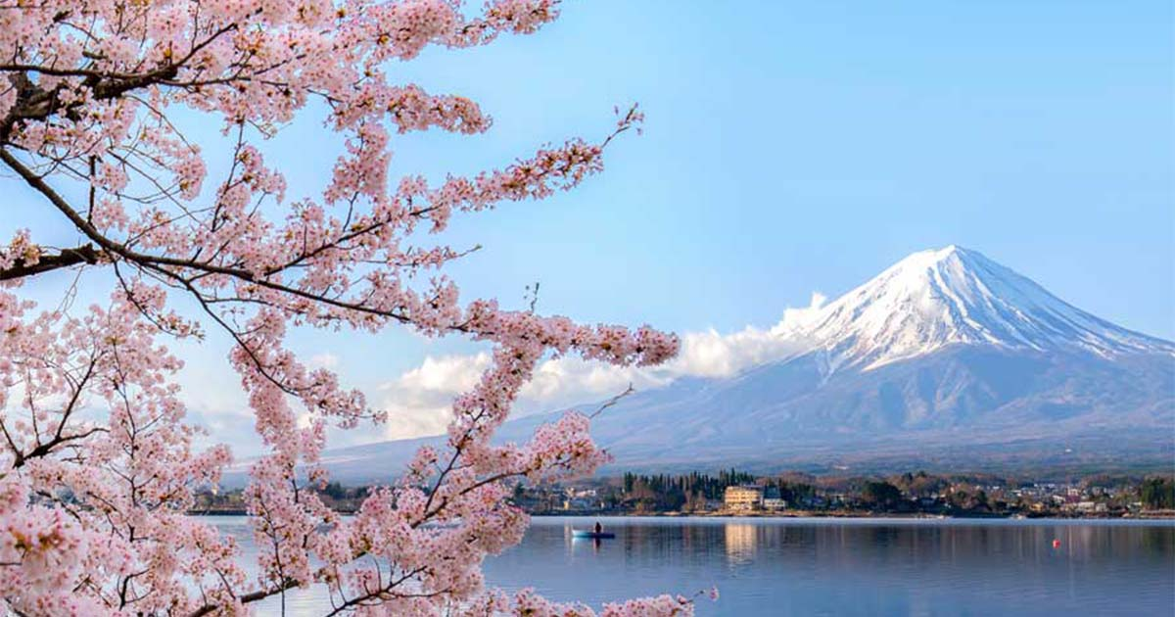
Japanese language
Linda Čápová

Slide 2
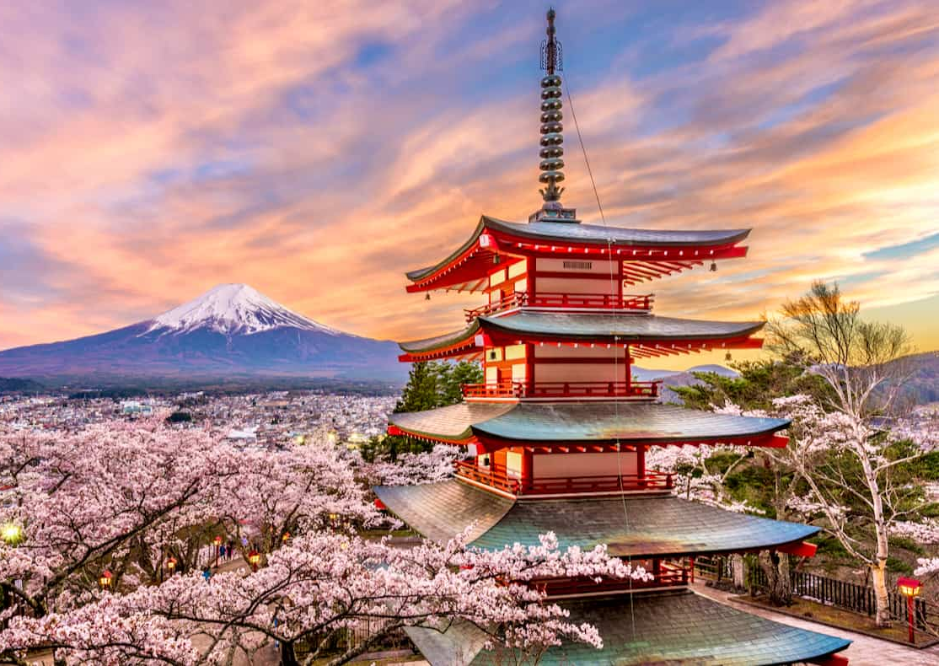
History
We don't know how was created- probably from Korean and Chinese
Characters from chinese

Slide 3
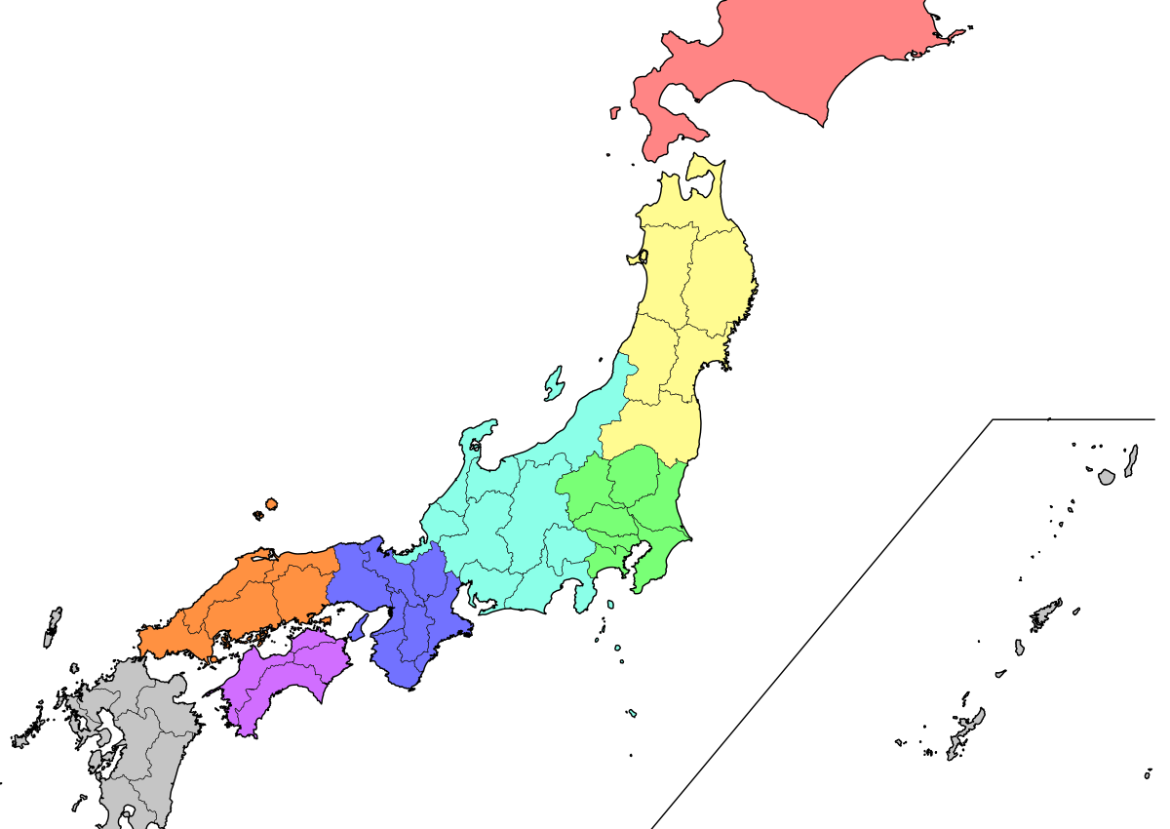
Basic information
About 128 mil. Speakers
The official language of Japan
very unigue and there is no other language similiar to it
The accent is different in different parts of Japan
Part of japonic language family

Slide 4
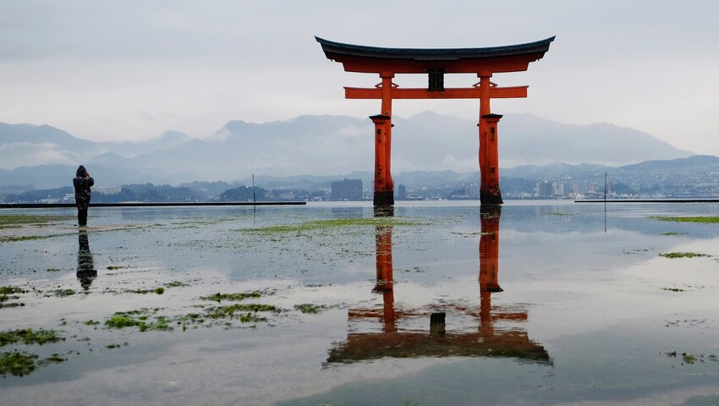
Japanese alphabets
Hiragana
Katakana
Kanji
Romaji

Slide 5
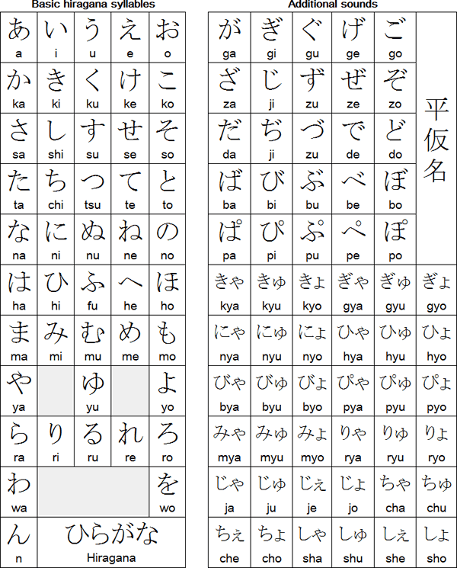
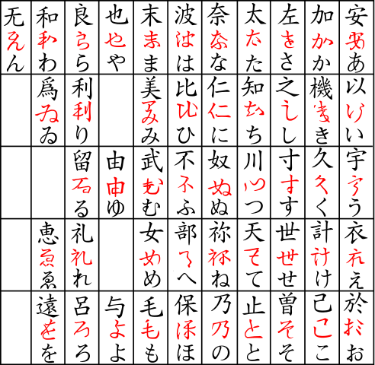
Hiragana (syllable)

Slide 6
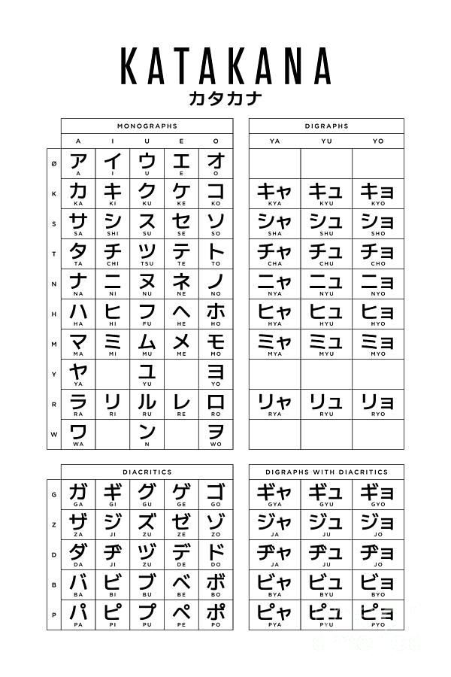
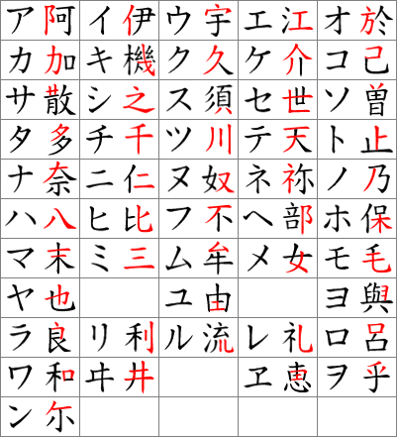
Katakana (syllable)

Slide 7
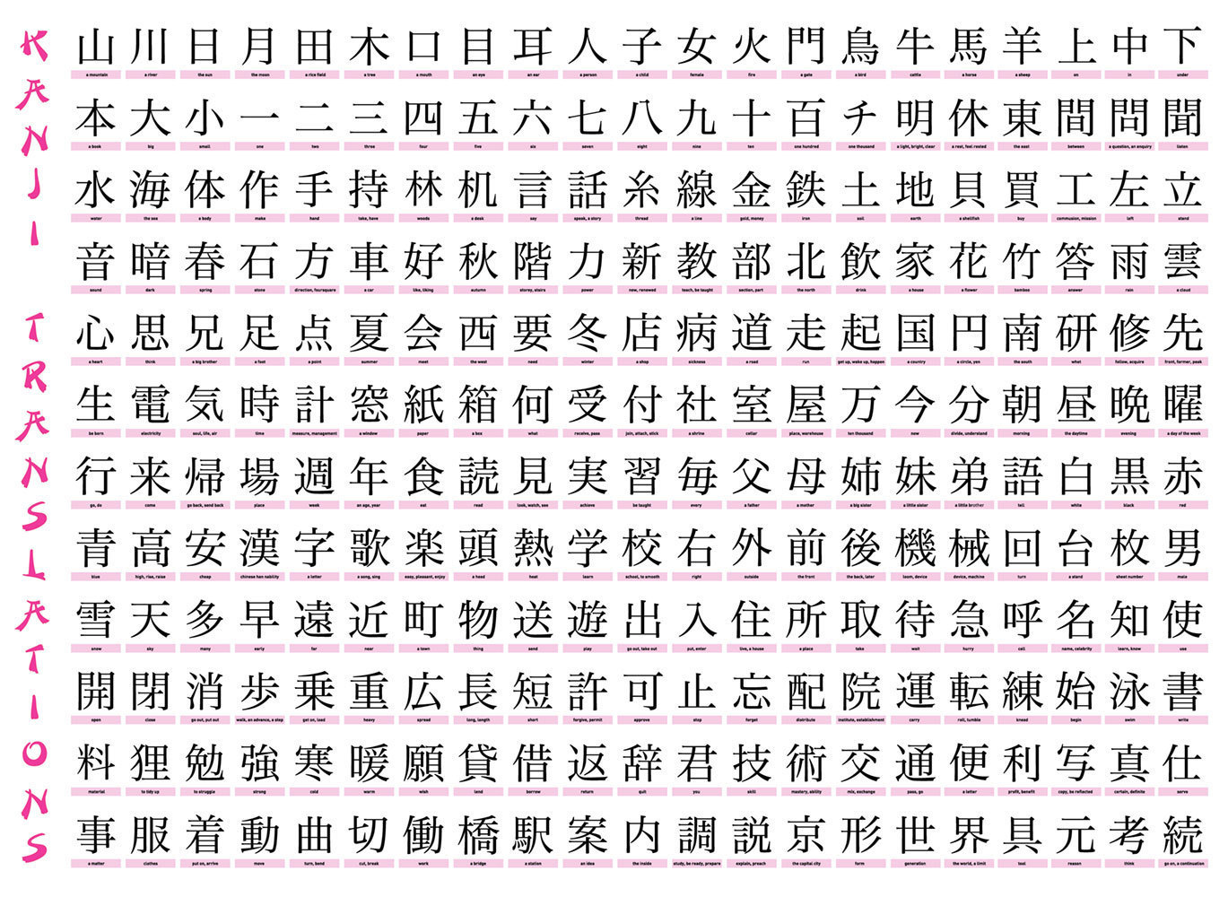
Kanji (words)
More than 4000 characters

Slide 8
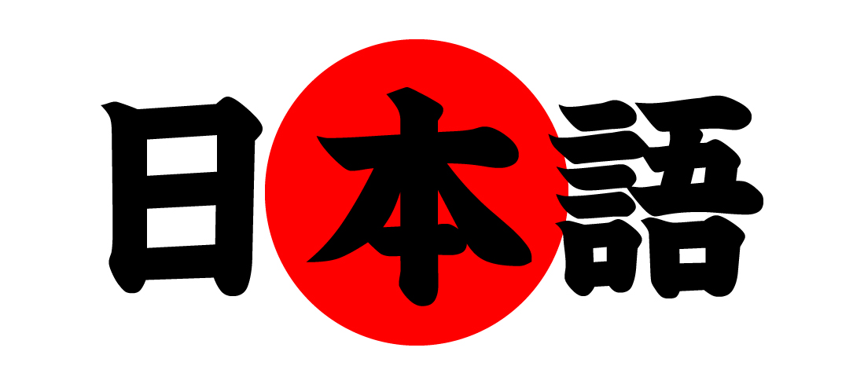
My learning journey
I started 2 years ago
Japanese class

Slide 9
Resources:
https://en.wikipedia.org/wiki/Japanese_language
Japanese teacher

