Slide 1
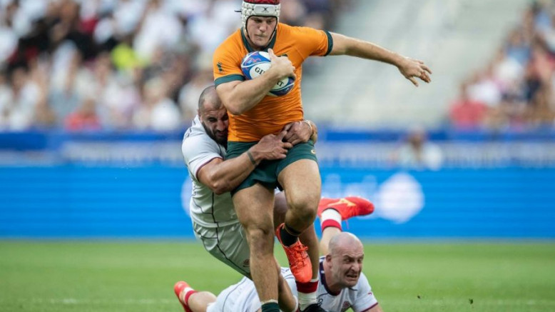
Rugby
Filip Budina

Slide 2
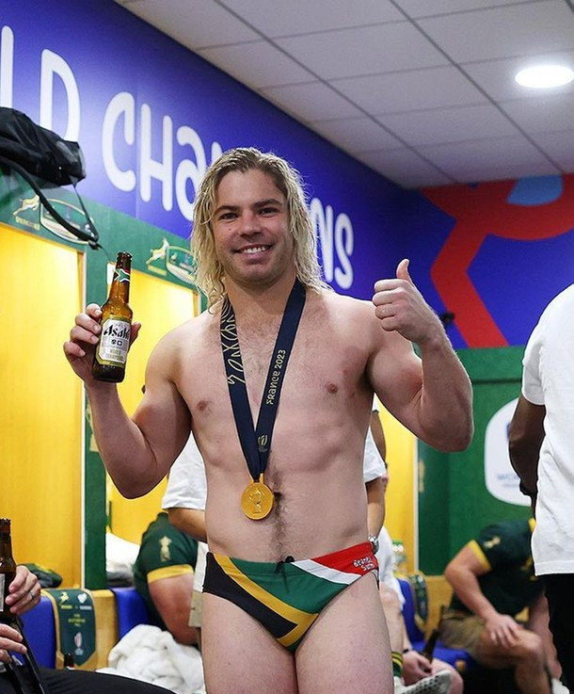
Basic rules
You must pass the ball behind you
You must stay on your feet in a ruck
It is forbiden to say swear words on the pitch
There can´t be more than 15 players on the pitch

Slide 3
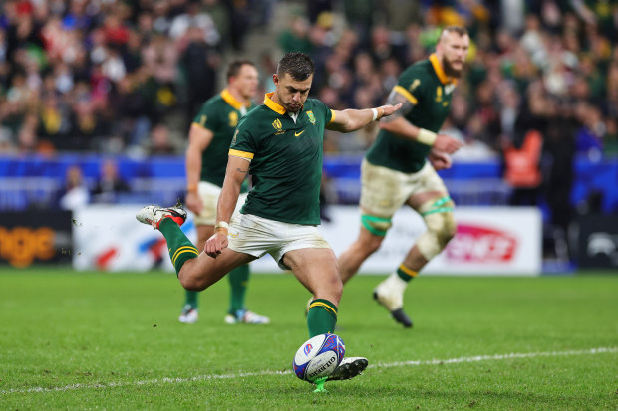
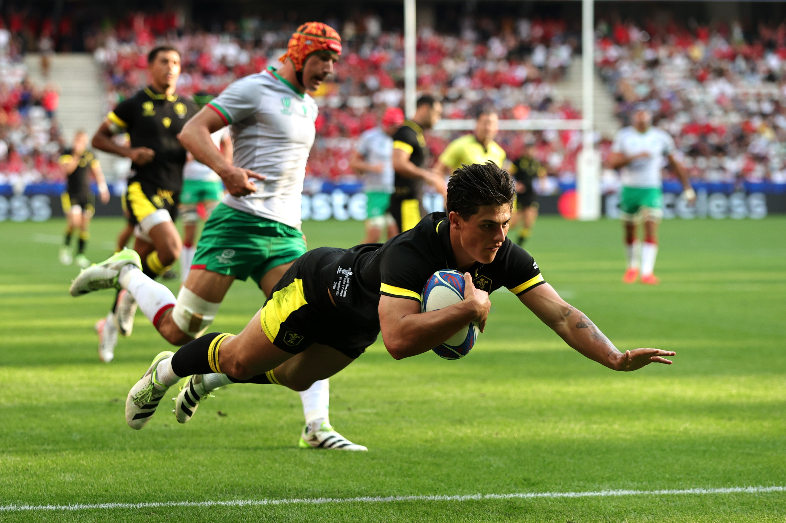
Rugby in attack
Rugby is a ball game where you have to break through a wall of 15 players a score a try
Rugby has a special oval ball
A try is when you cross all 15 players and touch the ball in the goal area. When you score a try you get 5 points
After a try you can score a conversion for another 2 points
A conversion is when you kick the ball through a big H like sign

Slide 4
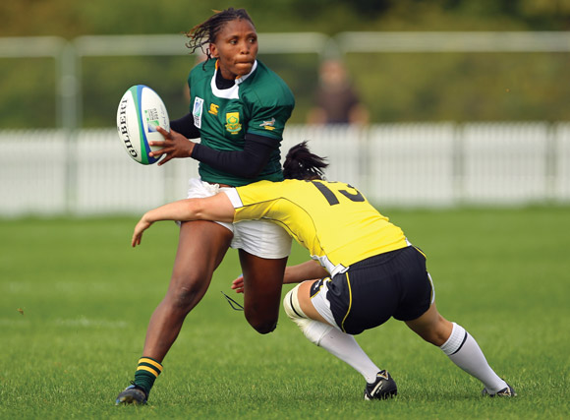
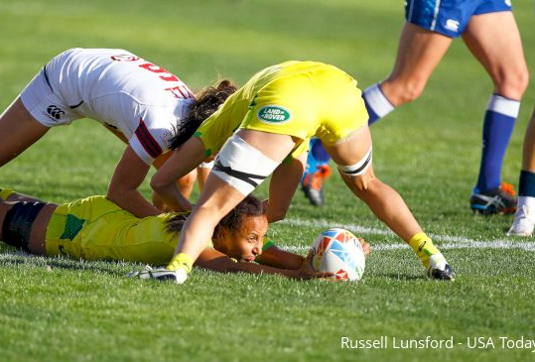
Rugby in defense
When you are in defense and somebody is running into you, you have to make a tackle
A tackle is used by the defending team to stop the attacking team from moving forward
After you make a tackle you have a chance to get the ball out of the ruck
A ruck is a situation when severel people from both teams are trying to get the ball from the tackled player and you have to stand on your feet

Slide 5
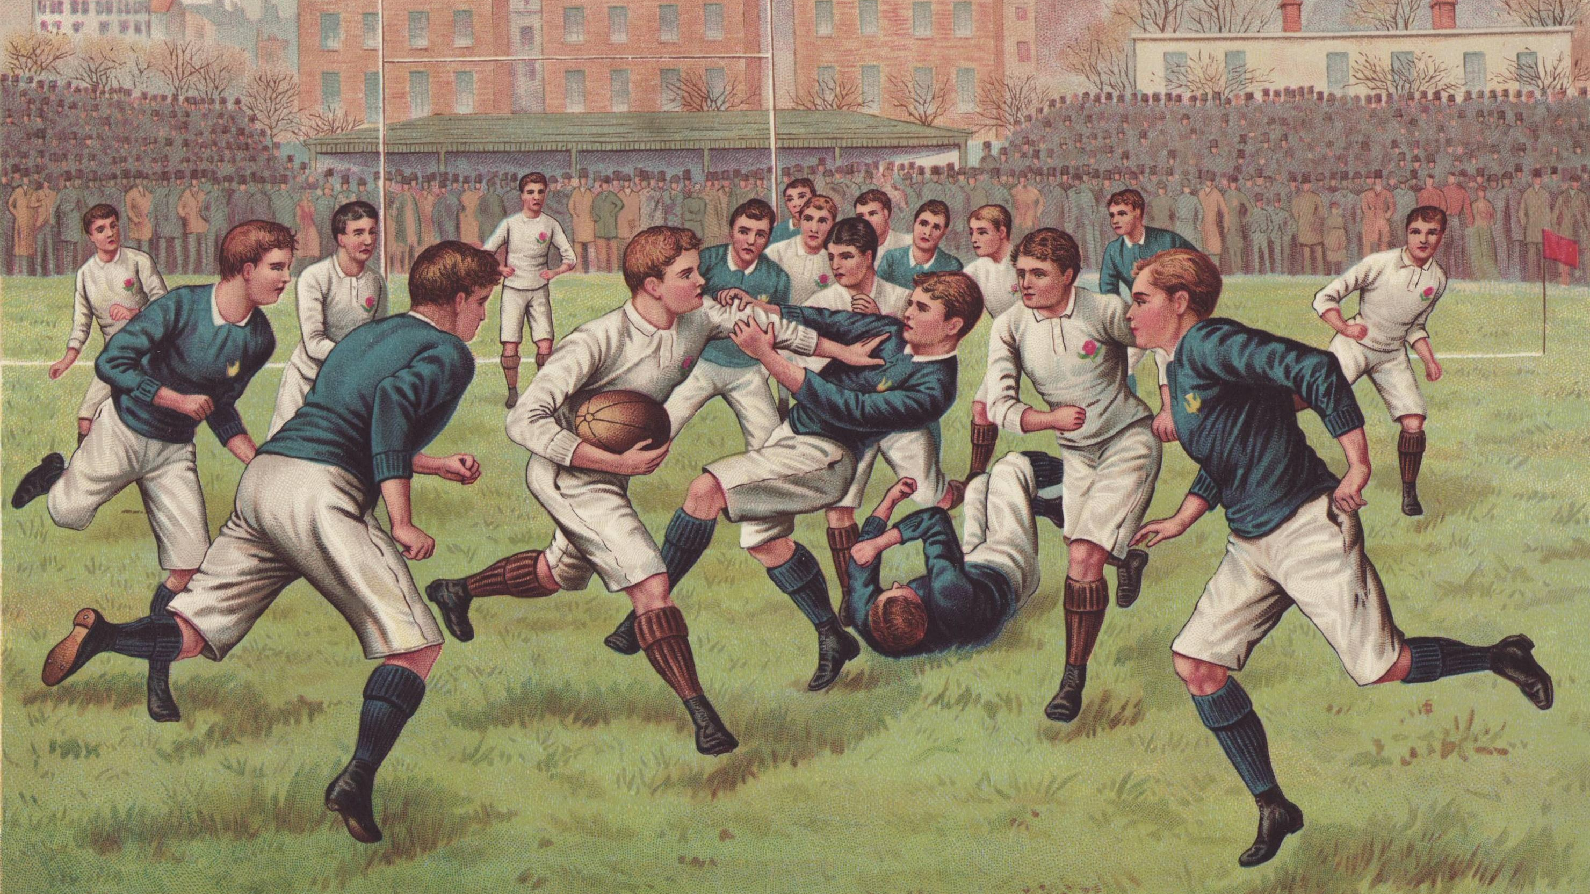
Rugby´s history
It is said that rugby was created at a rugby school in Warwickshire at England, 1823
In these years the ball was much bigger and rounder than it is today
The rules were fully invented in the year 1845
At the beginning of rugby there were 20 players on the pitch instead of 15 players
Later on it was considered as the most brutal sport because there was no protection at the time

Slide 6
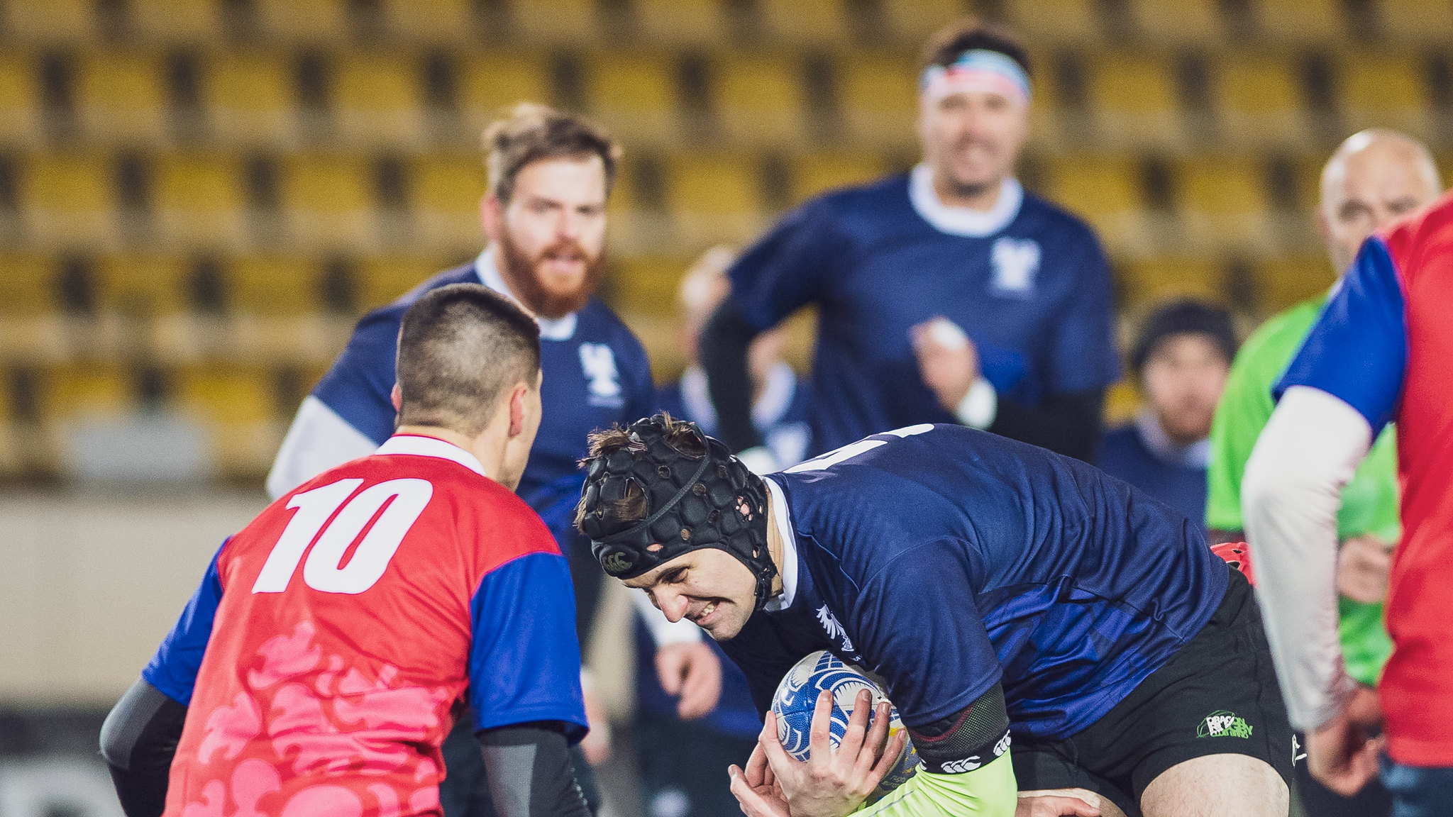
Rugby in the Czech Republic
Our National team was created in the year 1993 after the split of
Czechoslovakia
We now compete in the European Nations Cup
We haven´t qualified to the World Cup so far
In here the sport is still non-professional

Slide 7
Thank you for your patience

